Slide 1



Ways to
Participate in ITU
Activities
26 Sep 2024

Slide 2
Agenda
A set of 10 Opportunities to engage in Pre-standards, standards and Code.
[Free GPUs inside]

Slide 3





Opportunity-1: ITU AI/ML Challenges
To analyse sound of rain
analyze energy consumption from 100 basestations from HKT
large dataset to identify high probability of landslide
The Challenge provides carefully selected problem statements, a combination of open data from real-world and simulations, supported by technical webinars from experts, mentoring, and practical hands-on sessions.
Given a real world problem, how to solve it using AI/ML?

Slide 4
ITU Challenge repository
ITU AI/ML Challenges
ITU Journal
1 | Can I find good quality data to analyse?
2 | I need reference code for ML pipelines
3 | I need to read/publish quality research on AI
4 | How do I map AI/ML to standards?
5 | Can I get free GPUs?
6 | Can I get a support forum?
Open Code
ITU ML5G Standards
Free GPUs for participants
Webinars and mentoring

Slide 5

What we offer in the Challenge!
Creating a community of value
Students and professionals
Expert talks (webinars)
Round-tables
Hands on sessions
Mentorship
Baseline models
Notes:
The aim of the challenge is to create a community that solves network related problems using AI/ML
Through crowd-sourcing, solutions from the challenge will accelerate (pre) standards development, application of AI/ML in networks and research
The solutions of the Challenge provides practical solutions that are shared as open source
The challenge also encourages collaboration and healthy competition. Mentors will guide participants in order to maximize learning and engage students and professionals
The ITU AI/ML in 5G Challenge offers several benefits to participants
Students and professionals compete by creating team of not more that 4 (If a team has a mentor or professor, then the team can have more than 4 members)
Through the Challenge, expert talks/webinars are organized on technical aspects of AI/ML in communication networks and to describe problem statements for the Challenge
Informal sessions called “Round-tables” are organized as well to make sure participants of the challenge engages with others and hosts on their progress
Participants are also exposed to mentorship, baseline models/codes, and Free ITU compute platform

Slide 6


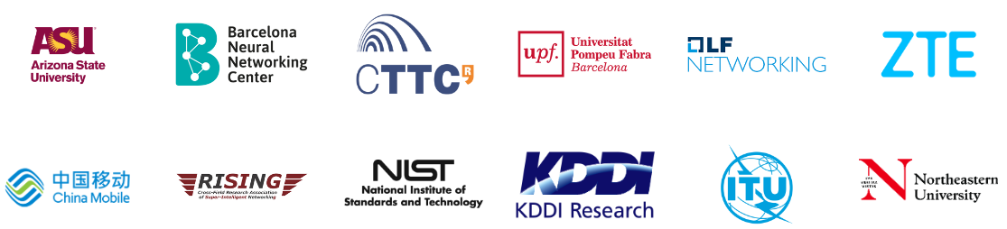

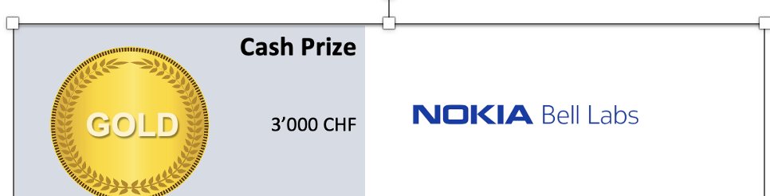


Some of the ITU AI/ML 5G Challenge partners
2020-now

Slide 7
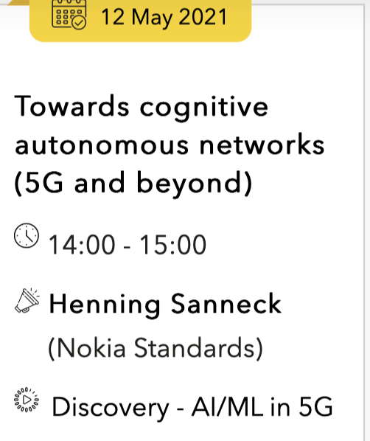
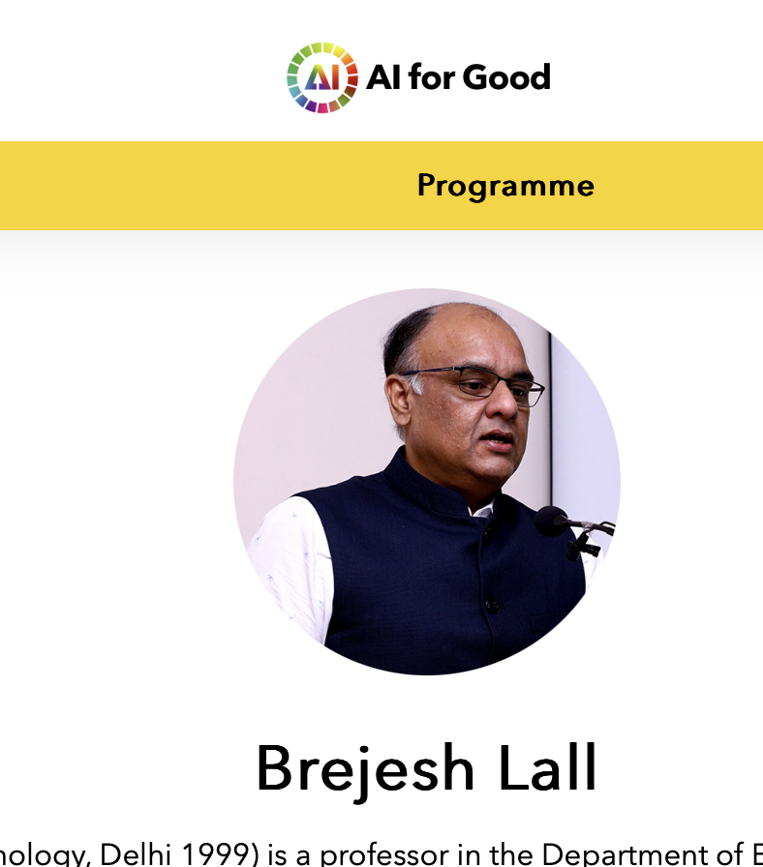
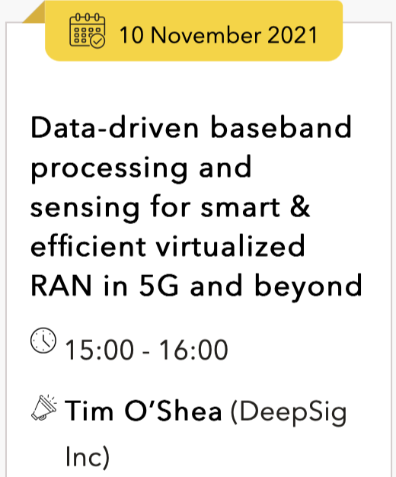
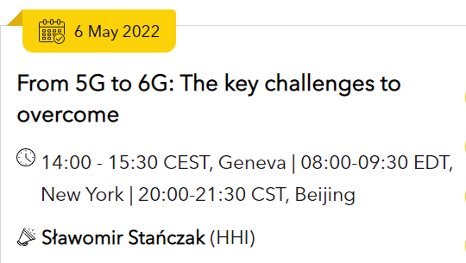
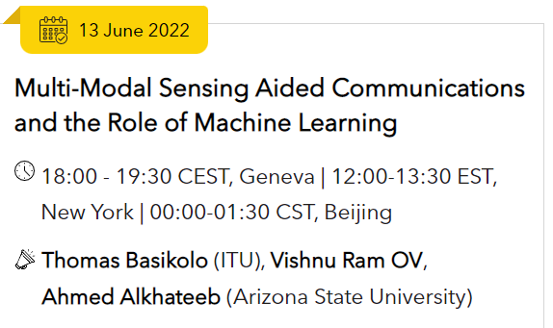
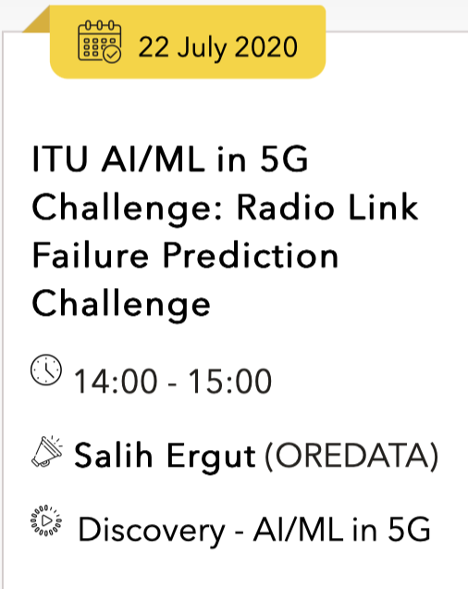
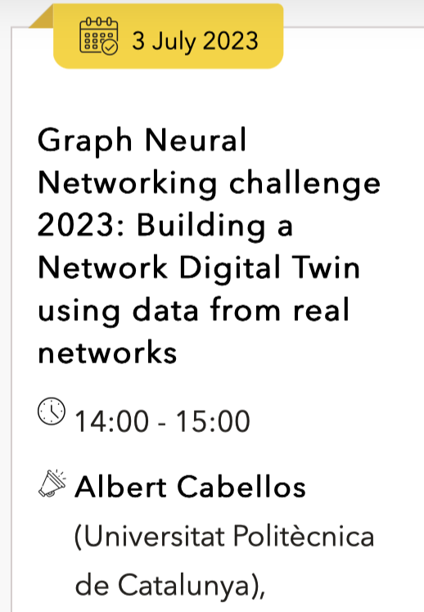
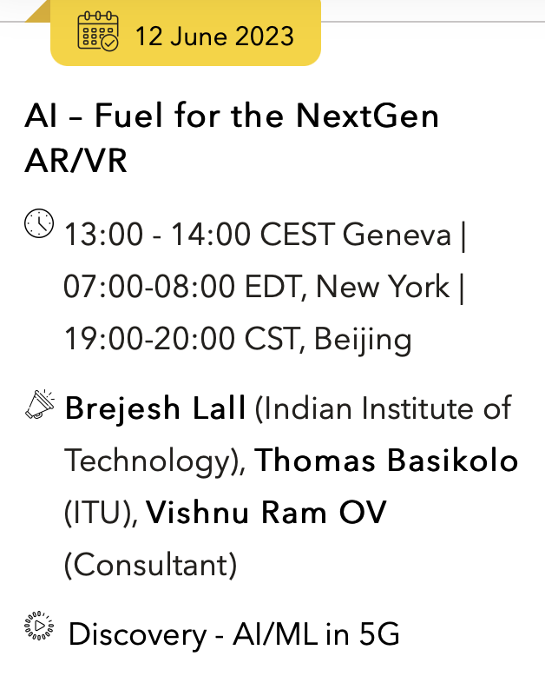
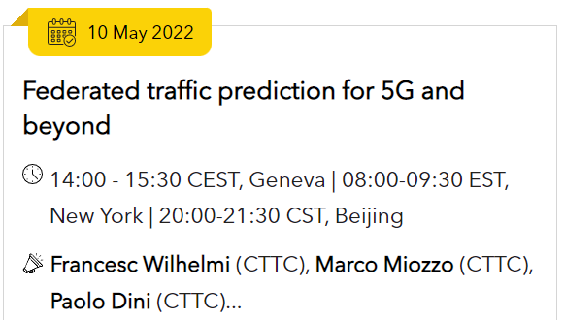
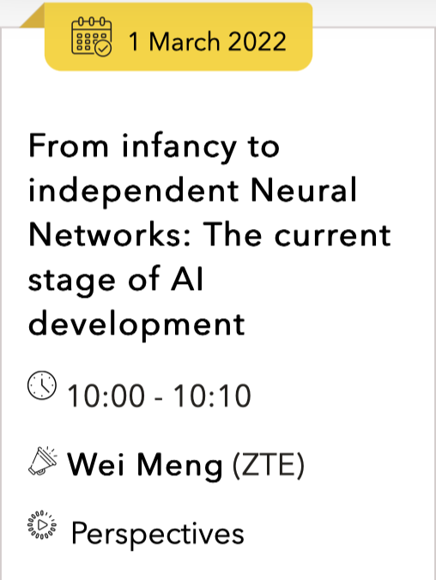
Opportunity-2: ITU AI4Good webinars
100+ Webinars since 2020
> 10,000 views in 2021
https://aiforgood.itu.int/eventcat/ai-ml-in-5g/

Slide 8



Opportunity-3: Special Issue publications with ITU Journal -JFET
>100 GitHub repositories
Code, Reports, Slides
10 Papers published in J-FET [2020]
16 Papers published in J-FET [2021]
Special Issue paper review underway [2023]
Papers in ACM, IEEE, Conferences

Slide 9
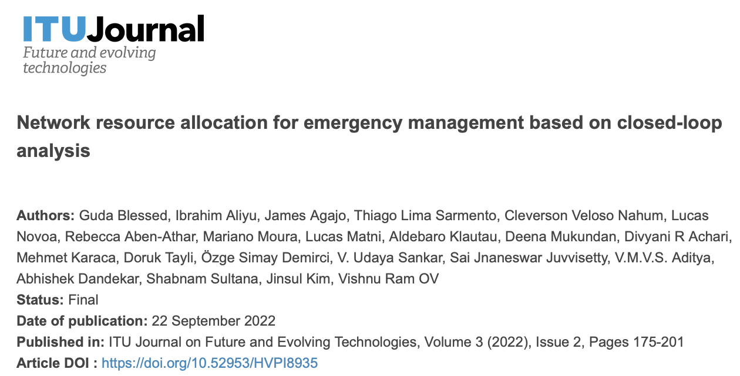
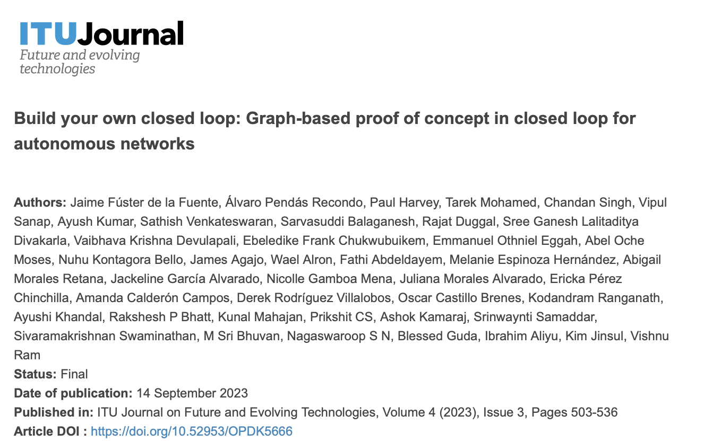
ITU Journal Publications
2022 paper based on Build-a-thon PoC
2023 paper based on Build-a-thon PoC

Slide 10
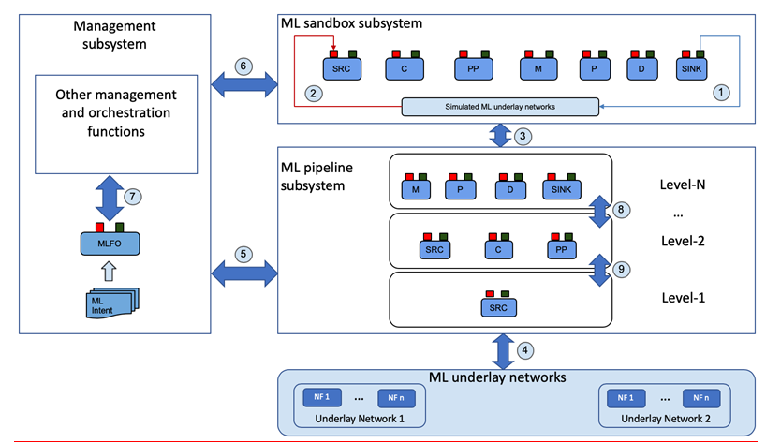
Opportunity-4: Pre-standards - FG ML5G [2018-2020]
Published use cases for ML in 5G
ITU-T Y.3172
Student mentoring projects
ITU-T Y.3172
ITU-T Y.3172, “Architectural framework for machine learning in future networks including IMT-2020”, was one of the most downloaded “fresh” ITU-T standards.

Slide 11
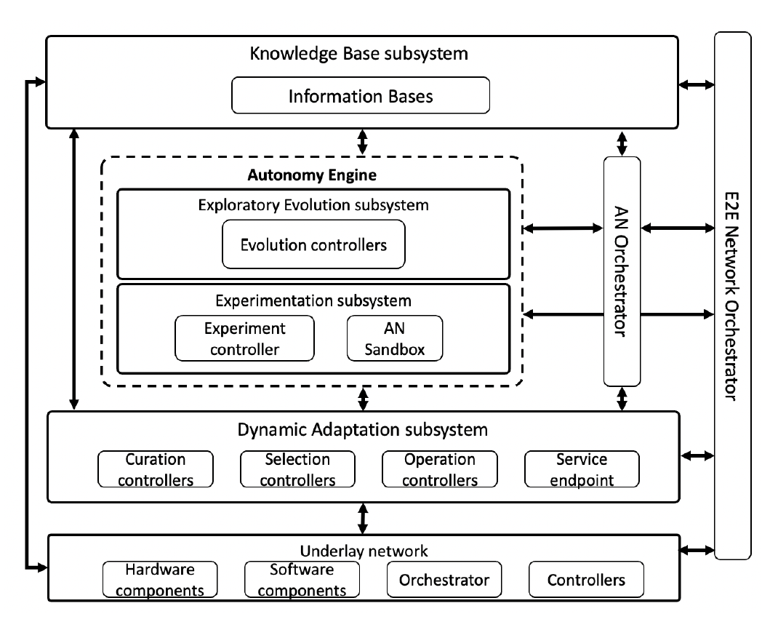
FG AN frameworks [2020-2023]
Published use cases for AN
Arch framework for AN
Build-a-thon PoC
ITU-T Y.3061
Build-a-thon PoC from FG AN has seen 100+ participants since 2020

Slide 12
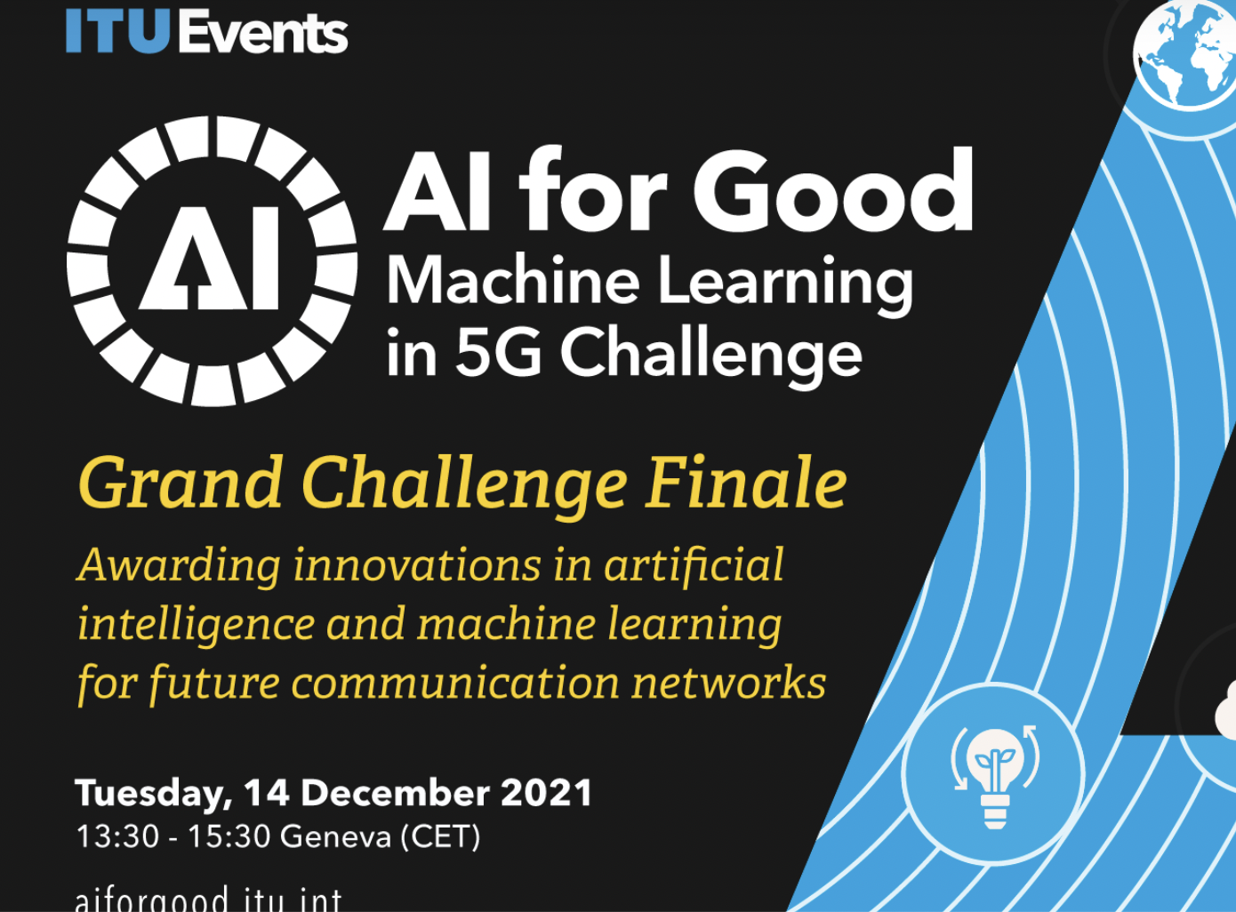
Opportunity-5: ITU FG AN Build-a-thon 2022
https://challenge.aiforgood.itu.int/match/matchitem/68
11 teams submissions from
India, Japan, Egypt, Costa Rica, Nigeria and UAE.
Reference code: https://github.com/vrra/FGAN-Build-a-thon-2022
All reports are available from: https://extranet.itu.int/sites/itu-t/focusgroups/an/input/FGAN-I-289-R6.docx
ITU Reference code used Neo4j Aura DB and Google colab.
The actors in ITU use cases were represented as nodes and the neo4j relationships captured the use case interactions.
All 40 ITU use cases with 300+ nodes and 500+ relationships were provided.
A public Jupyter notebook was provided with helper classes
Grand Challenge Finale
Registration opens
Registration closes
May 1
June 3
Oct 2022
Nov 2022
14 Dec 2022
kickoff workshop
Judging and demo event

Slide 13
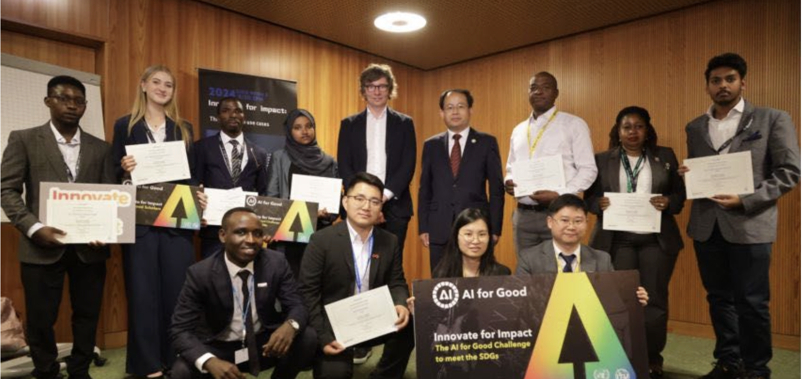
Opportunity-6: ITU AI/ML Student Mentoring
Mentoring Activities
Zimbabwe
Zambia
Ethiopia
Nigeria
Tanzania
India
Ghana
FG-ML5G-O-026
LS/o on How to engage students in ITU’s work? Lessons learnt from FG ML5G
(Focus Group on Machine Learning in future networks including IMT-2020) [ to all ITU-T SGs and ITU-T FGs]
Launched on 14 January 2020
By Slawomir Stanczak, Fraunhofer HHI, Germany
Chair, ITU FG ML5G.
2020-2024
Mr Prudhvi from SRM AP, India is one of the AI for Good Scholar for 2024.
Innovate for Impact Workshop: AI for Good Scholars
118 scholar applications, 35 countries spanning Asia, Africa, Europe, Latin America, and North America

Slide 14
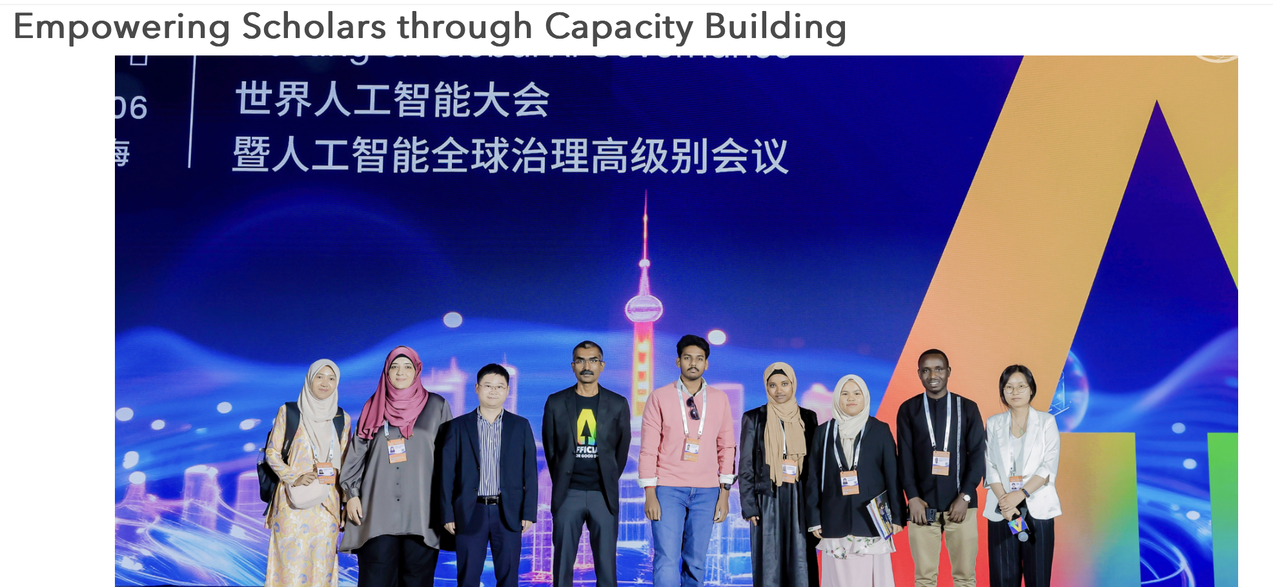
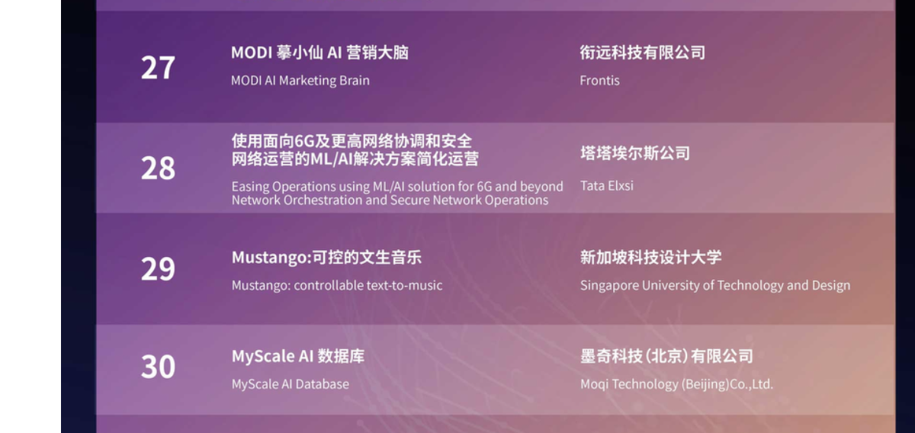
Key Outcomes from AI for Good Innovate for Impact
AI for Good Innovate for Impact event held during the World Artificial Intelligence Conference (WAIC) in Shanghai 2024
https://www.jiqizhixin.com/articles/2024-06-07-9
https://aiforgood.itu.int/key-outcomes-from-ai-for-good-innovate-for-impact/
Tata Elxsi use case in SAIL (Super AI Leader) award in Shanghai
the first Indian company to be nominated.

Slide 15
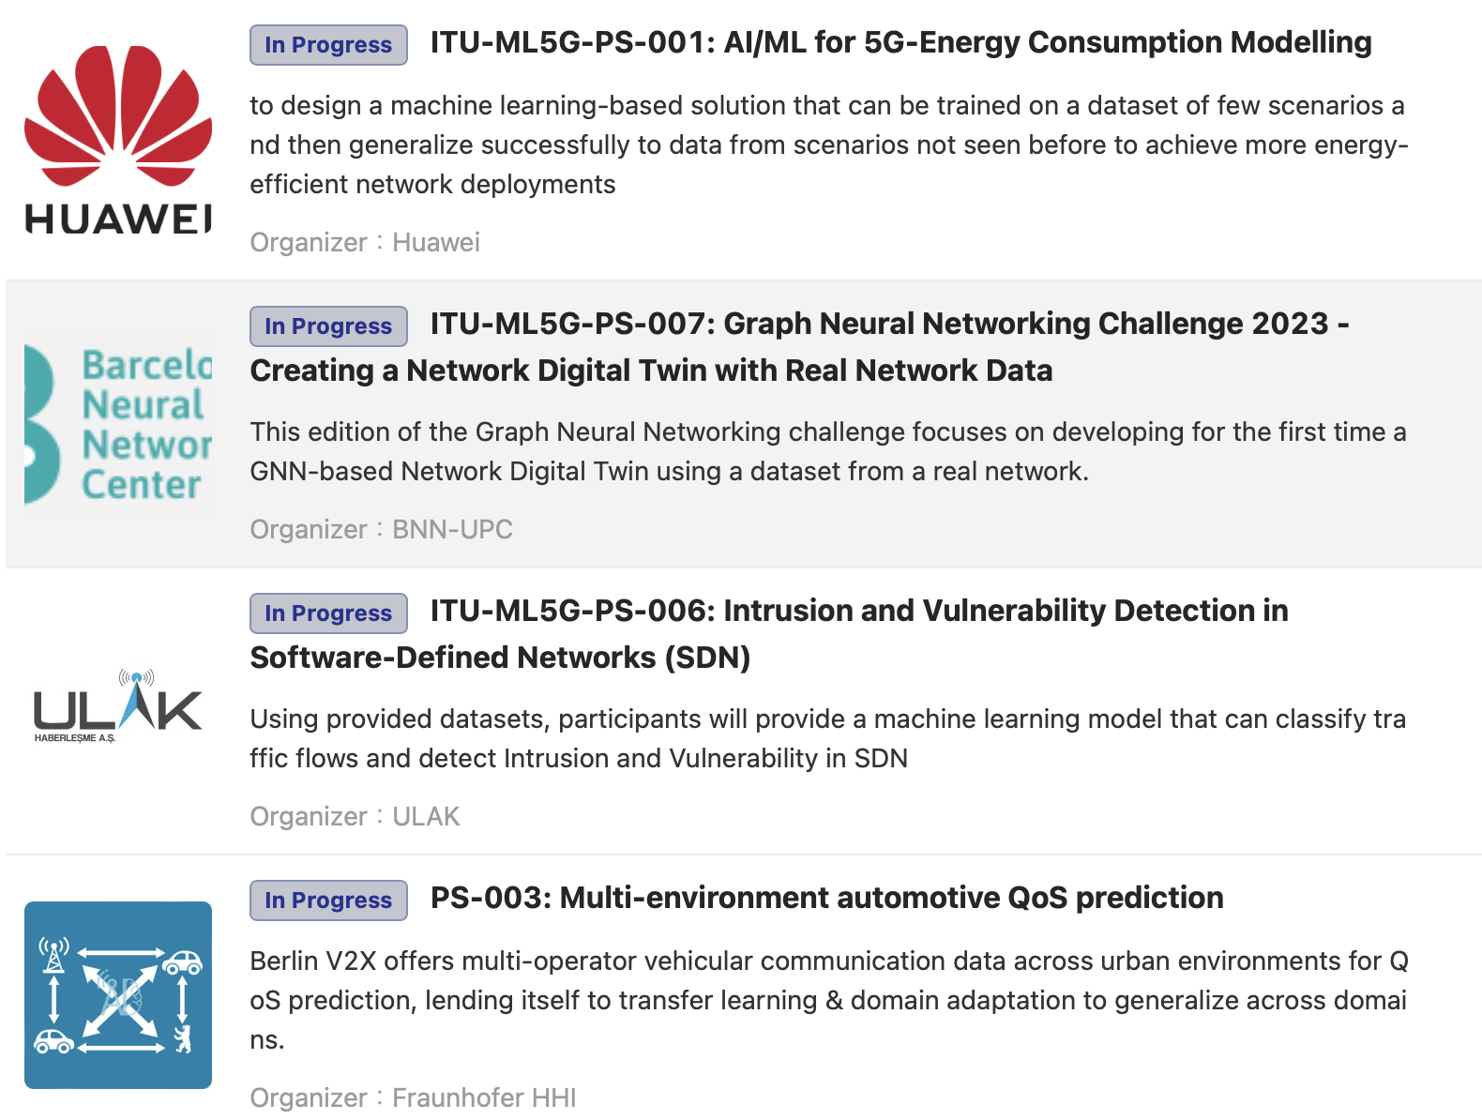
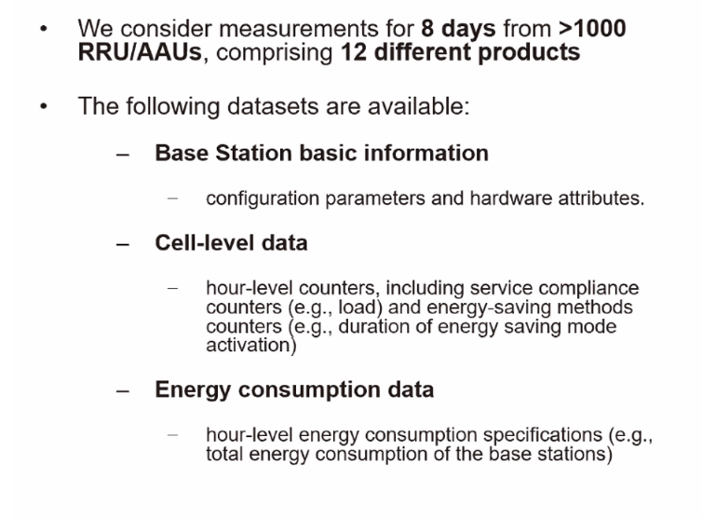
Opportunity-7: Open datasets
https://challenge.aiforgood.itu.int
https://www.youtube.com/watch?v=zSetefnu3y8

Slide 16
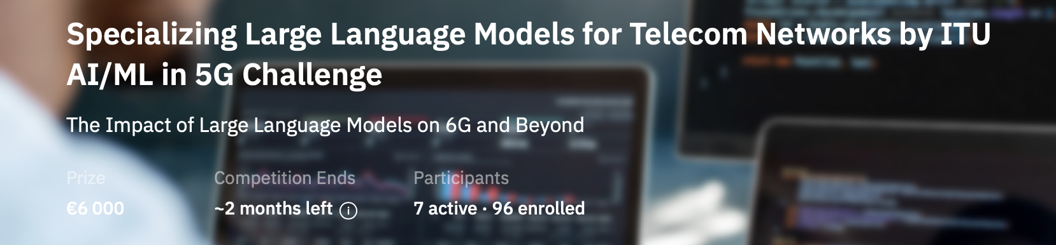
Open datasets
Specialize Falcon 7.5B on telecom knowledge: In this task, the participants will download Falcon 7.5B model [3] (https://huggingface.co/tiiuae/falcon-7b), and improve such model on their local computing facilities.
The participants will be required to enhance the accuracy of the baseline model when answering to the multiple-choice questions included in the TeleQnA dataset by developing novel solutions or combining existing methods such as Retrieval Augmented Generation (RAG) and prompt engineering.
Specialize Phi-2 on telecom knowledge: In this task, the participants will download Phi-2 [4] (https://huggingface.co/microsoft/phi-2), and improve such model on their local computing facilities.

Slide 17


Opportunity-8: Data pipeline
Model Marketplace
ITU calls for partners to join the efforts to make India as AI ready.
Use cases for SDGs in AI
Pre-standard analysis
Open Data
ITU Cloud
ITU members and partners
Code
Sandbox Validation reports
ai-readiness@itu.int
Gold-Standard data,
Baselined and maintained,
Open and shared,
Key to future standards and opensource
Expert annotators, reviewers, Technical Advisory Committee

Slide 18
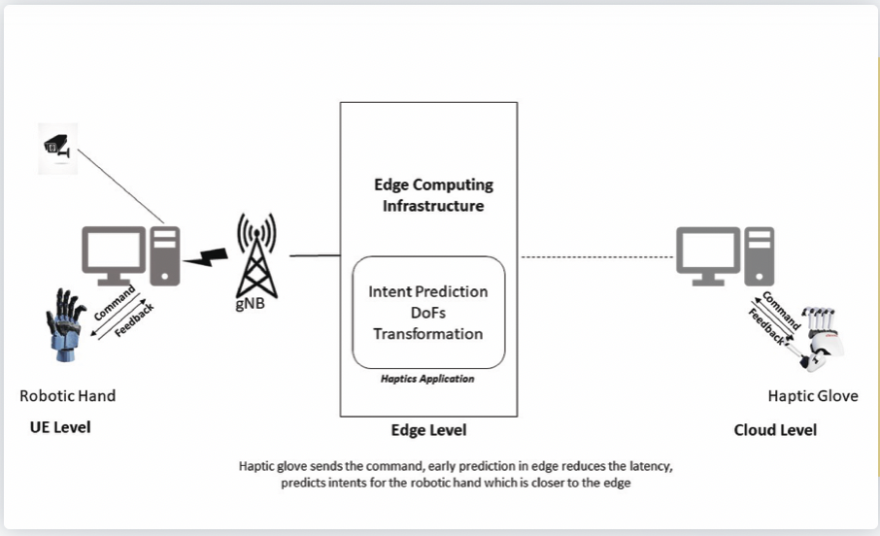
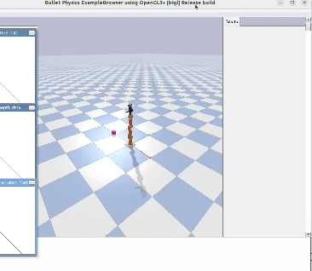
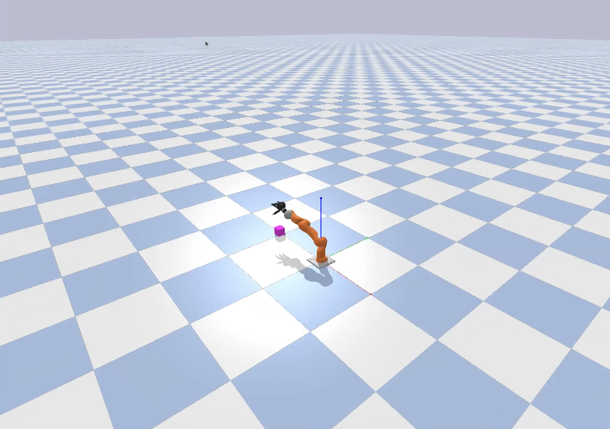
Testbeds are more important than real networks
MEC Test Bed integrated with 5G Core conforming ETSI standards
Time series Labeled Datasets were provided
tested on the Test-Bed with actual hardware (Allegro Hand and Haptic glove)
APIs for the test bed to integrate
References: [FGAN-I-289-R5]
Problem statement I - Slip Detection and Force Estimation
Problem statement II - Object Detection
https://bhartischool.iitd.ac.in/build_a_thon/index.html

Slide 19
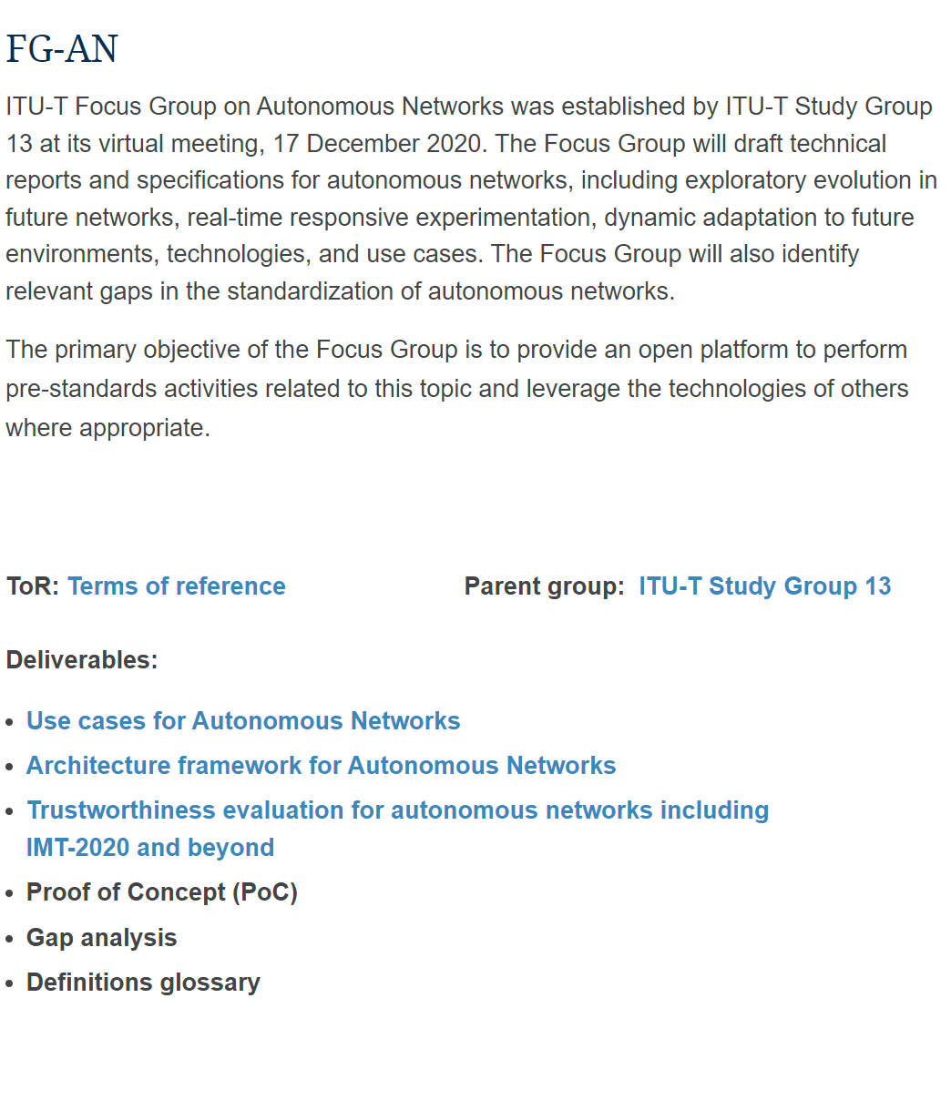
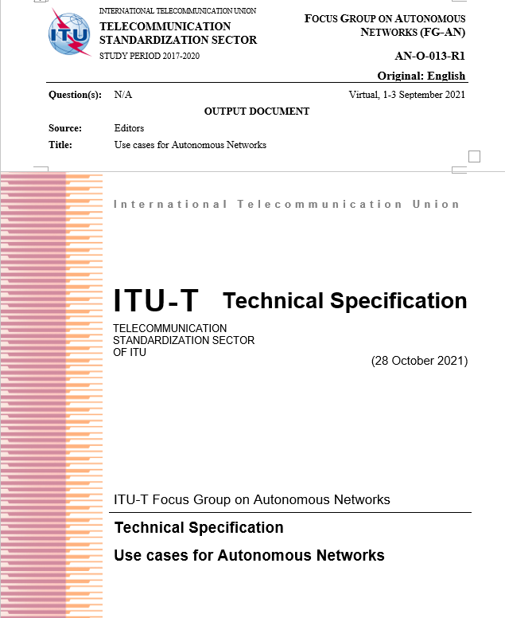
Standards & Use cases
Opportunity-9:
Link to use cases
https://www.itu.int/en/ITU-T/focusgroups/an/Pages/default.aspx

Slide 20
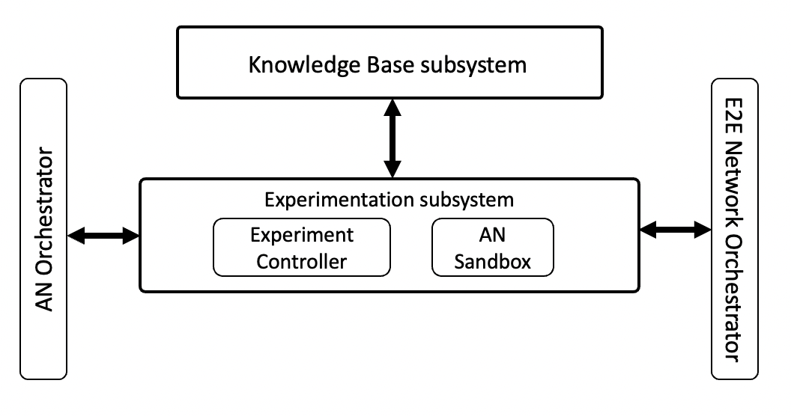
Sample use case: the pattern
Critical requirements
AN-UC027-REQ-002: It is critical that AN-triggered experiments and adaptations are tested using corresponding simulator settings in DT and the impact in simulated environment is evaluated.
AN-UC027-REQ-001: It is critical that AN enable import of simulation environment into DT, trigger simulations in DT and validate the results, especially the use case specific closed loops.
Derived requirements
Derived architecture components

Slide 21

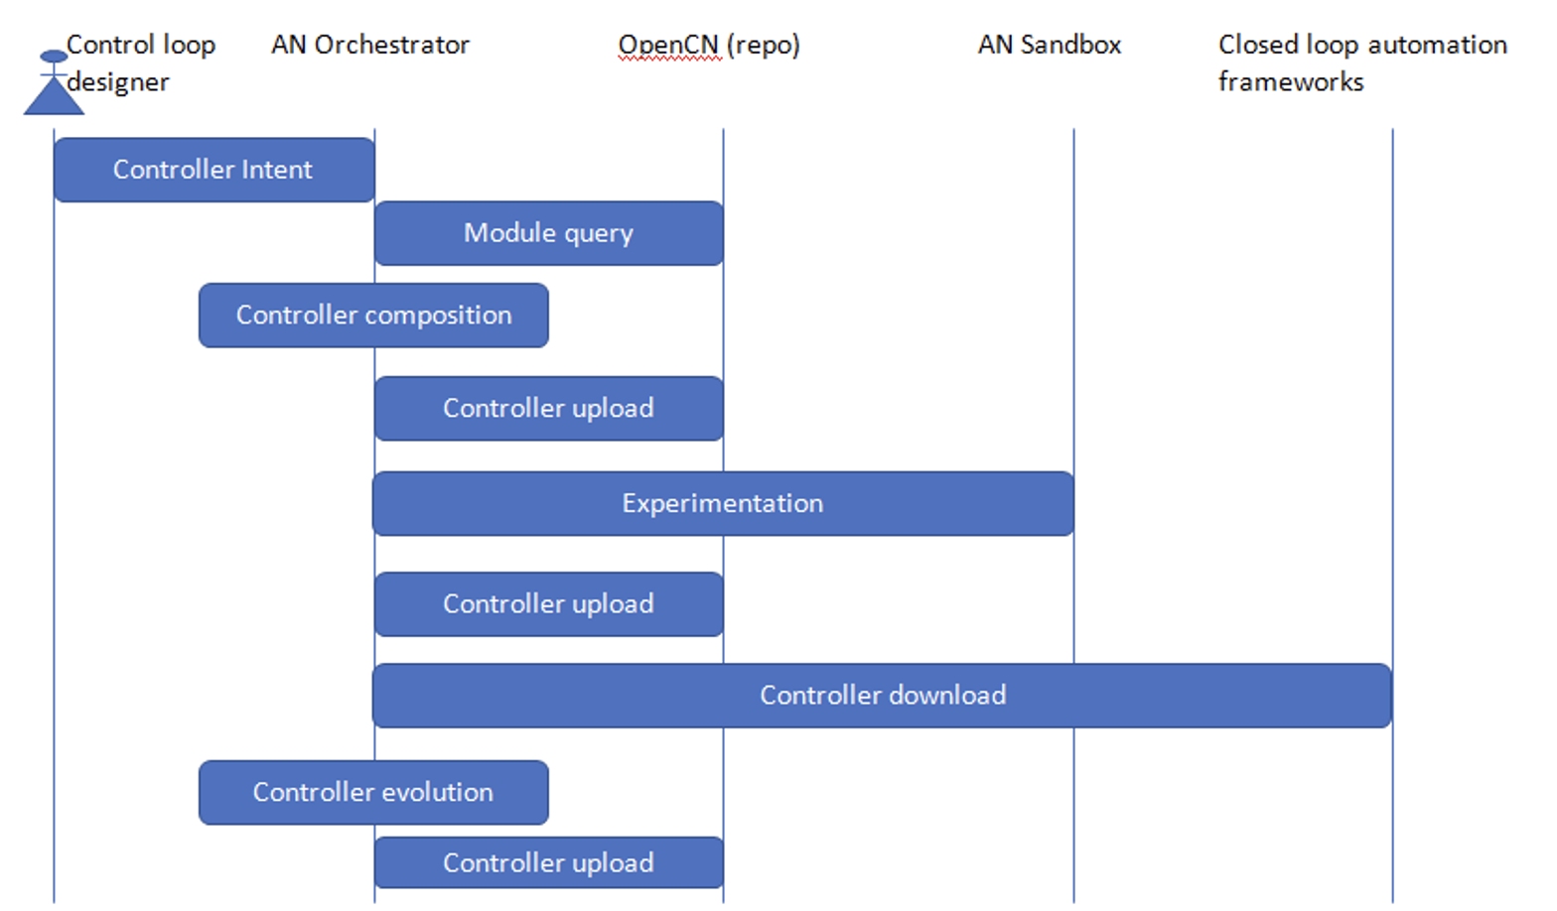
Sample usecase (continued)
actor
actor
actor
actor
actor
Initial version of a workflow formed from intent or composition from modules These may be stored in the repo labelled as “untested” or candidate controllers
Experimentation (Ex) manager pulls the candidates from the repo and (uses a sandbox to) evaluate and test and compare the modules and workflows
Evolution strategies are applied on the workflows and modules
pulled and deployed in networks
Designer
orchestrator
repo
sandbox
Deployment frameworks
We had text descriptions of the use case like this
We had figures describing the interactions in the use case like this
interactions
References:
[FGAN-O-013-R1]

Slide 22
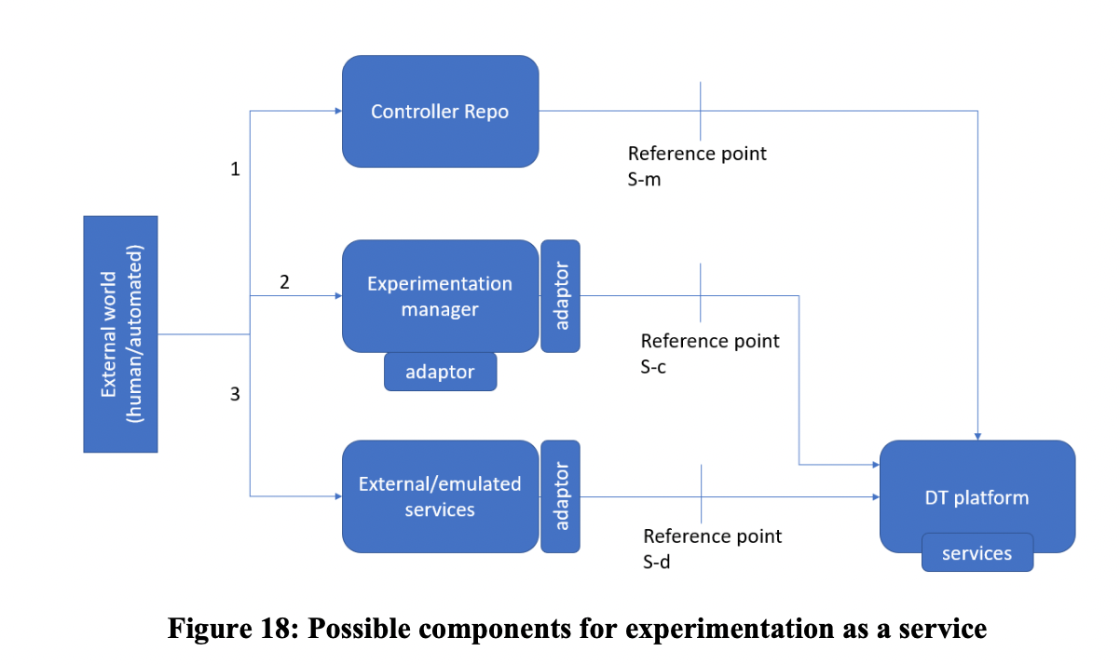
Sample use case: component figures
actor
We had figures describing the components involved in the use case like this
actor
actor
actor
actor
References:
[FGAN-O-013-R1]

Slide 23
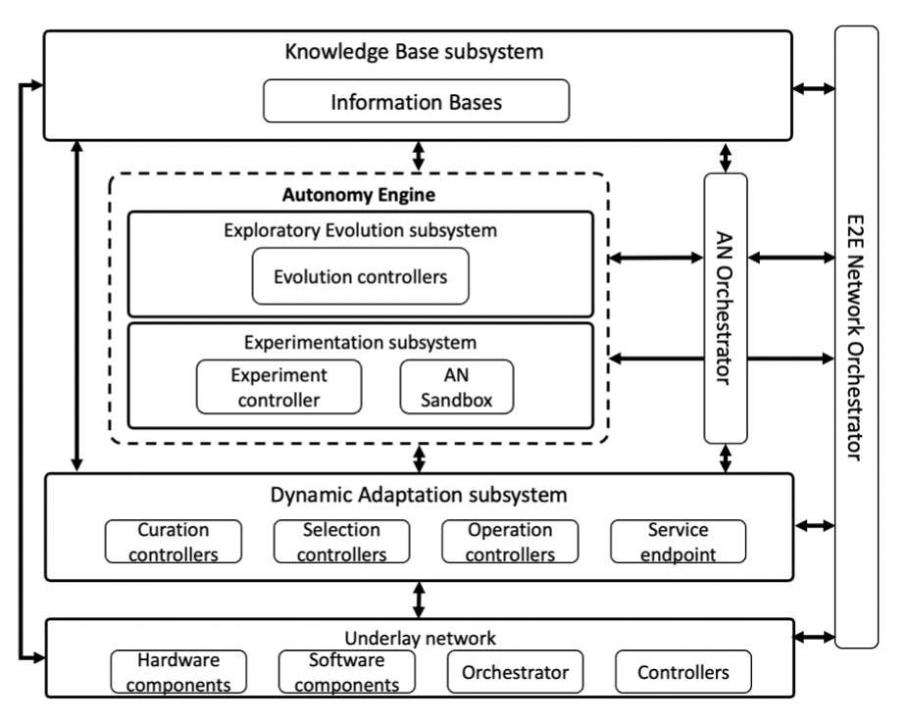




Applying AI/ML for evolution of the network
Create the “blocks”
Compose “larger blocks”
Test and validate
Apply in the network
Go back to step-1
Source: ITU-T Y.3061 : Architecture framework for Autonomous Networks

Slide 24
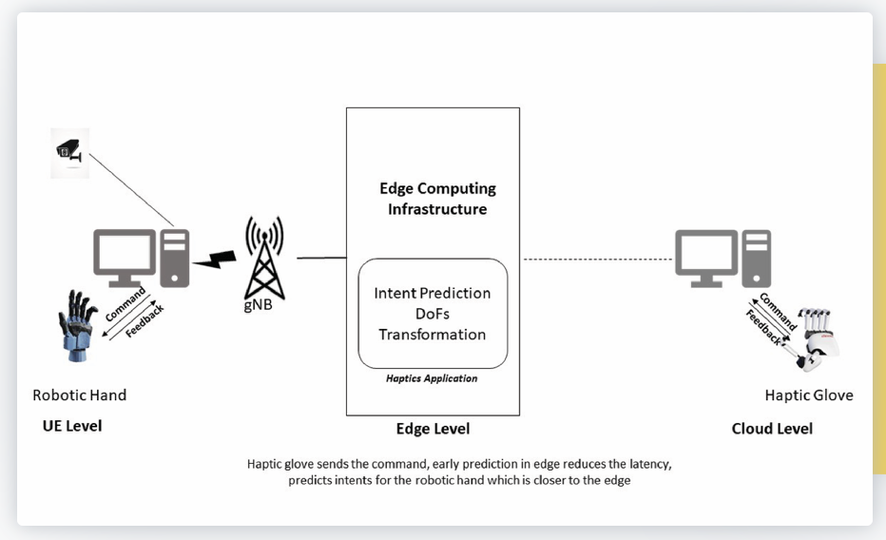
Sample application
● AN-UCxx-REQ-001: it is critical that AN enable intent prediction at the edge.
● AN-UCxx-REQ-002: it is critical that AN captures various application specific constraints (e.g. “Without breaking or deforming the object” )
● AN-UCxx-REQ-003: it is critical that AN enable integration of optimization mechanisms e.g. using AI/ML, automation mechanisms.
Example Only.
From : https://bhartischool.iitd.ac.in/build_a_thon/index.html

Slide 25
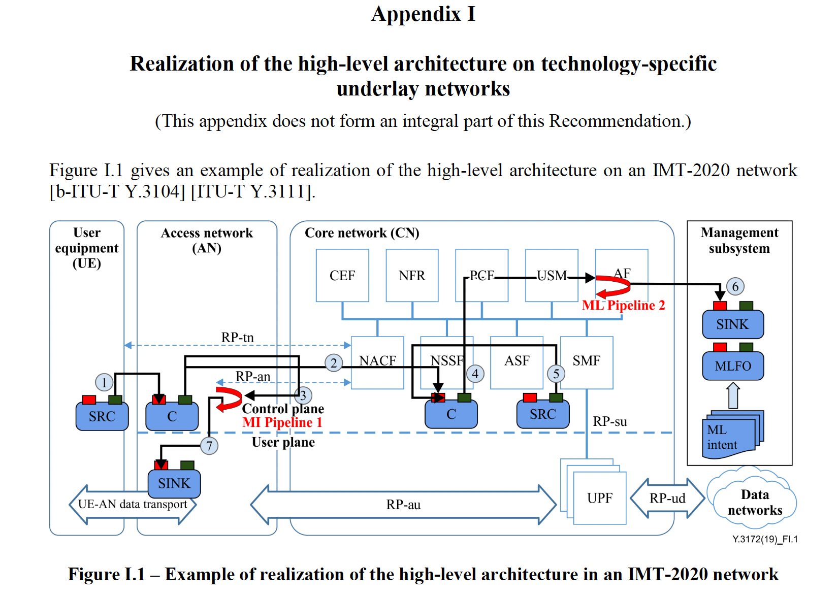
Sample pipeline

Slide 26






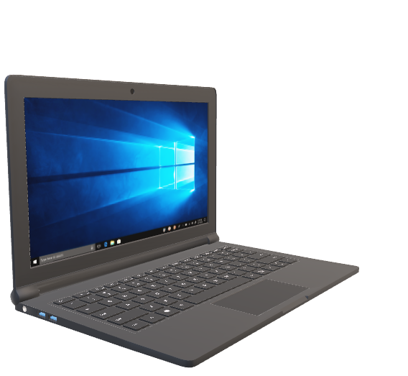
Opportunity-10: ITU provides – Free GPUs
Main Motivations
Level the playing field
Common reference solutions based on standards
Encourage collaboration and quality submissions.
Create a Sandbox of cross-domain knowledge
ITU provides State-of the art compute platform for Challenge participants
Free GPU access
Jupyter Notebooks
Python IDE

Slide 27
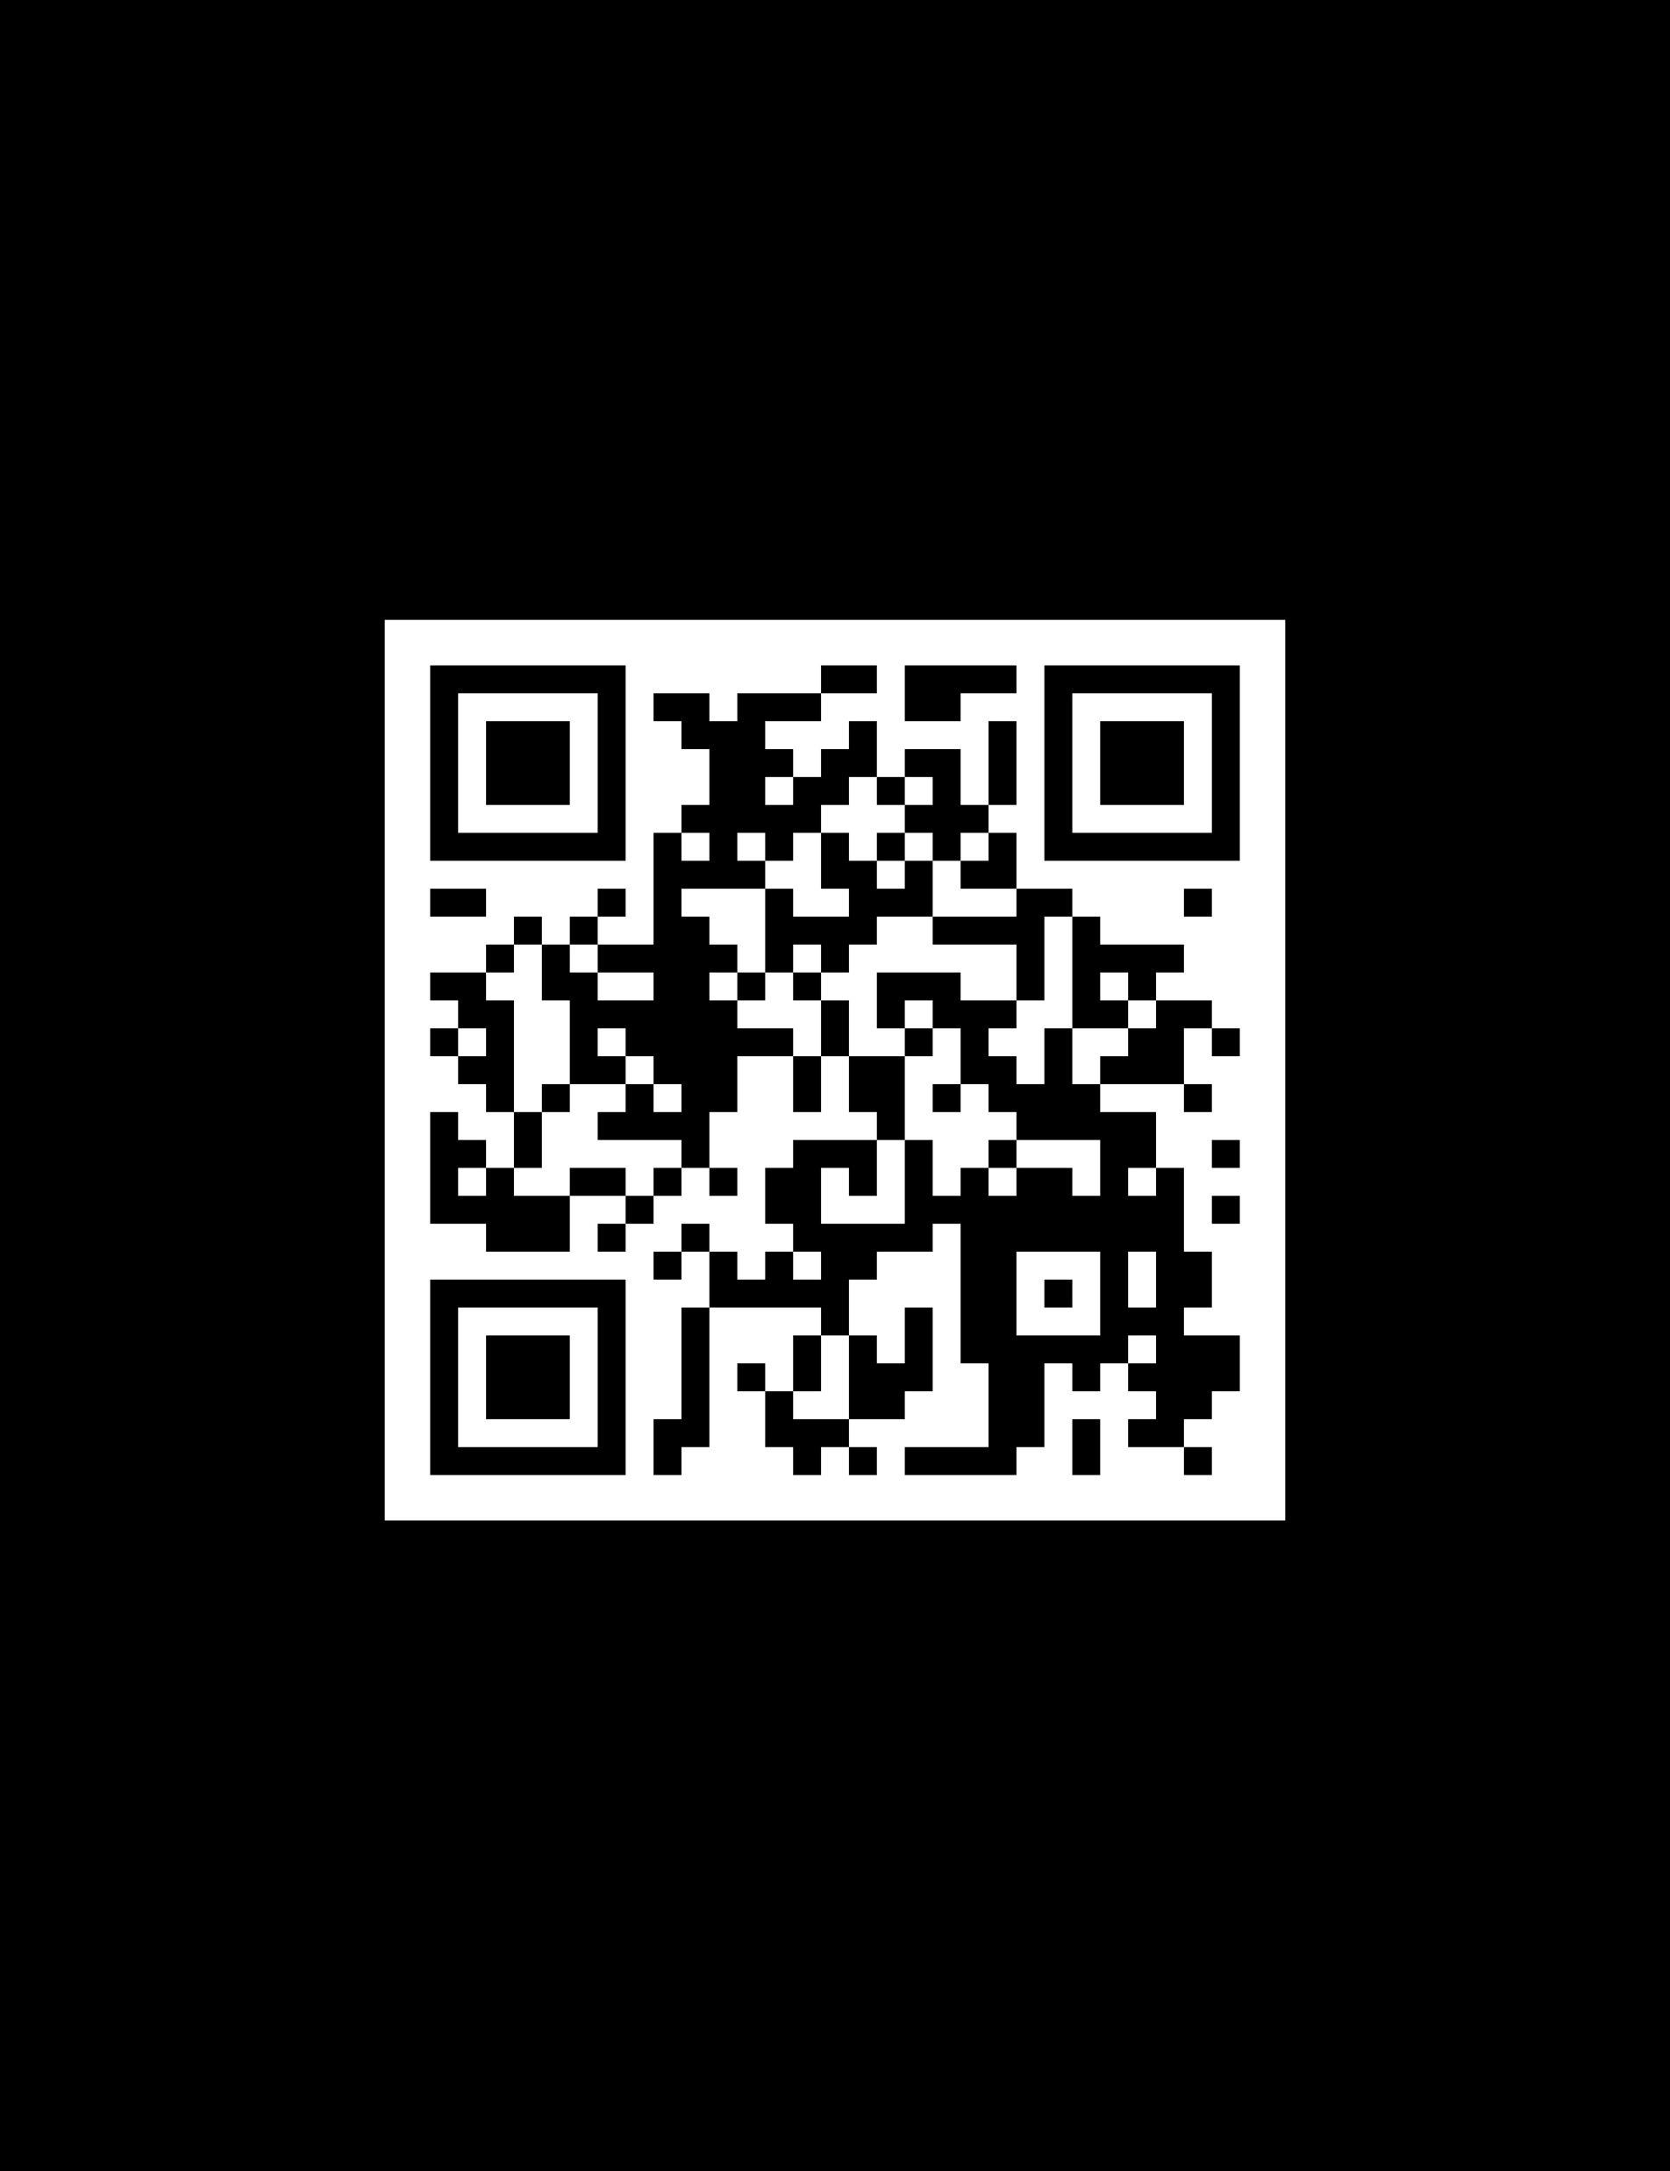

Midnight Marathon – go from “zero to hero” 27 and 28 Sep 2024 6pm IST onwards.
AI generated image from https://www.canva.com

Slide 28
References
AI/ML in 5G Challenge
https://aiforgood.itu.int/about-ai-for-good/aiml-in-5g-challenge/
FG ML5G
https://www.itu.int/en/ITU-T/focusgroups/ml5g/Pages/default.aspx
FG AN
https://www.itu.int/en/ITU-T/focusgroups/an/Pages/default.aspx
ITU-T J-FET Special Editions
https://www.itu.int/pub/S-JNL-VOL2.ISSUE4
https://www.itu.int/pub/S-JNL-VOL3.ISSUE2-2022
ML5G discovery series
https://aiforgood.itu.int/eventcat/ai-ml-in-5g/
ITU-T Y.3172
https://www.itu.int/rec/T-REC-Y.3172/en

Slide 29
Q&A Session

Slide 30
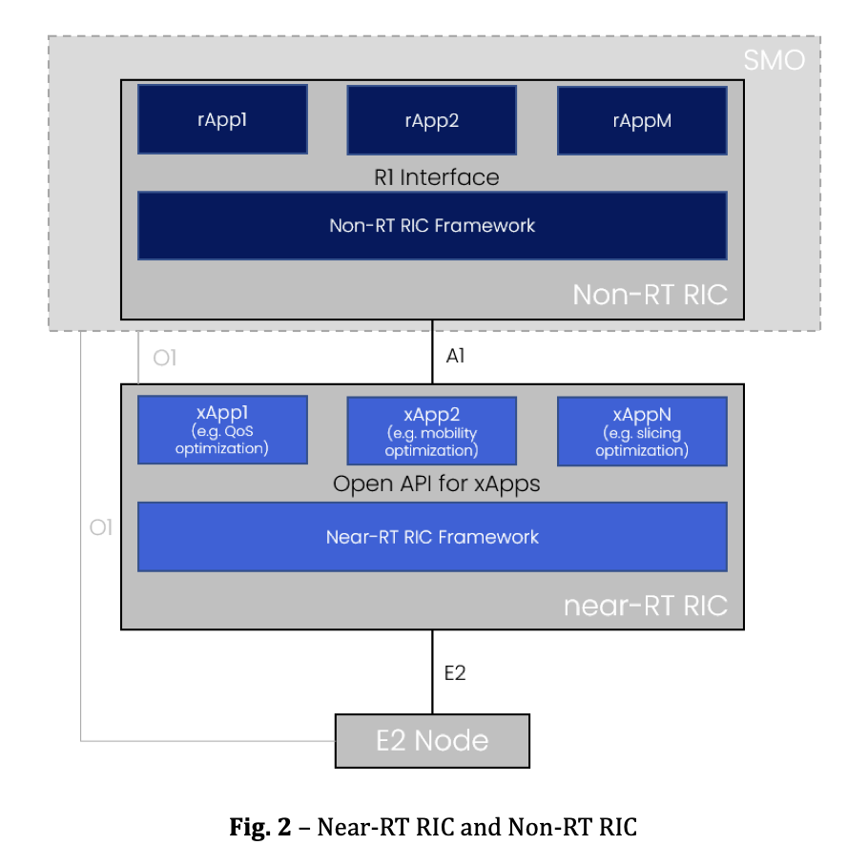
Step-1: Curate code and models
TAC-2 (China)
ML5G Challenge code
TAC generated Agents
Collection of Large Action Models
Experimentation Sandbox
Baseline Agents
Collection of agents (xApps)
Industry/academia simulations
Opensource PoCs
ITU Journal on Future and Evolving Technologies, Volume 4, Issue 2, June 2023

Slide 31
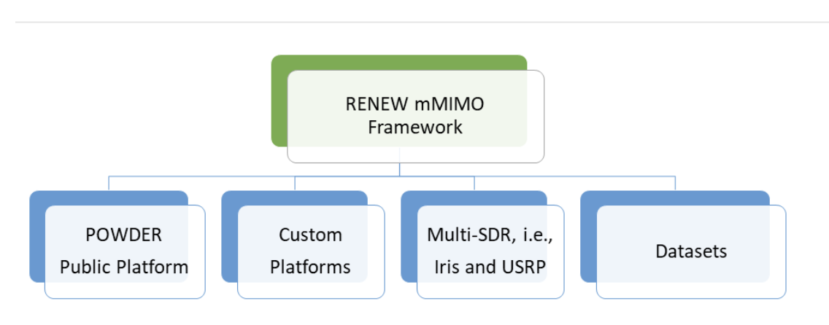
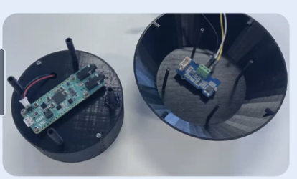

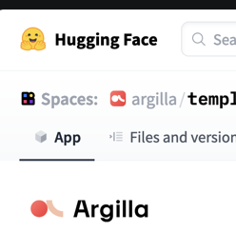
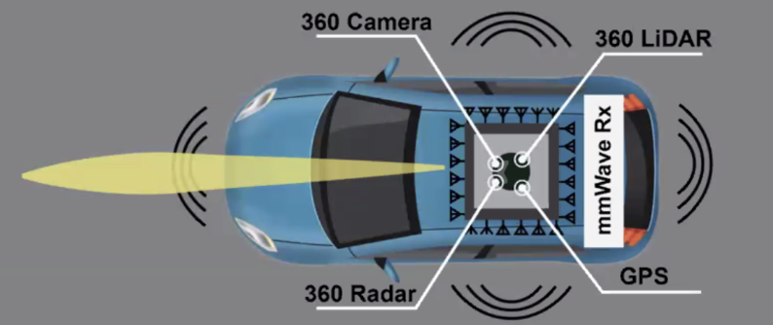
“Good data” – Creating good dataset costs time and money
Sound of rain to train smart weather station
Matches the use case,
Reflects real world scenario
Data is just 1 part of the puzzle
POWDER-RENEW is supported by National Sciense Foundation
https://aiforgood.itu.int/event/2023-tinyml-challenge-webinar /
https://challenge.aiforgood.itu.int/match/matchitem/93
Merge Blender and wireless site
LIDAR and visual data from Blender
Correlated, e.g. time, space
Vetted by domain experts
camera
LIDAR
https://aiforgood.itu.int/event/ai-ml-challenge-finale-multi-modal-v2v-beam-prediction-depth-map-estimation-in-6g-and-3d-location-estimation/
Annotated ITU FG documents as datasets
RADAR
GPS

